Slide 1

ehors-tech.com
WINX BY EHORS · HOSPITALITY OS
One platform. Every property.
From front desk to park gate.
WinX unifies PMS, POS, parks, spa, finance, and HR on one cloud-ready platform — real-time, with no day-end dependency.
70+
6
12
1
properties across APAC
countries · since 2005
integrated modules
login for everything
Notes:
WinX by EHORS: complete hospitality ERP. Live at 70+ properties in 6 countries since 2005. One system covers PMS, POS, theme parks, spa, finance and HR.

Slide 2
WHO IS EHORS
Two decades of hospitality engineering
2002
2005
2009
2010
2017
Today
Founded in Penang,
Malaysia — web-based
before "cloud" existed
First commercial
release goes live
Version 3 launches —
the platform running
today
R&D hub established
in the Philippines
MSC Malaysia
status awarded
70+ properties in
6 countries — hotels,
resorts, theme parks
Manila Ocean Park
Imperial Heritage · I’M Hotel
Petronas Pengerang
Oceanarium, Hotel H2O, retail, spa and kiosks — one install, one guest folio
Hotel, urban onsen spa and residences posting to one master folio
Enterprise-scale accommodation on a single WinX deployment
ehors-tech.com
2
Notes:
Founded 2002 in Penang; commercial since 2005; V3 since 2009. R&D in the Philippines since 2010, MSC status 2017. Flagship references: Manila Ocean Park, Imperial Heritage, Petronas Pengerang.

Slide 3

WHY ONE PLATFORM
Replace a patchwork of vendors with one system
The multi-vendor stack
The WinX way
Separate PMS, POS, accounting — licenses, renewals and interfaces for each
Guest data fragmented across systems; no single profile
Night-audit reconciliation delays every number until tomorrow
Revenue leaks between hotel, park, spa and outlets
Every new mandate (e-Invoice) becomes a project per system
One login, one database — every module already integrated
One folio bridges rooms, tickets, F&B and spa charges
Real-time folio-to-GL posting: P&L on the day, not month-end
One 360° guest profile at every touchpoint
Comply once — MyInvois e-Invoice built into the platform
ehors-tech.com
3
Notes:
Positioning: a multi-vendor stack multiplies license costs, interfaces and compliance work. WinX is one platform, one folio, one guest profile, real-time GL.

Slide 4













PLATFORM
Every department, one system
Front Office
Point of Sales
Accounting
Human Resource
Reservations → check-out
Restaurant · retail · fast food
GL · AP · AR · fixed assets
Biometric T&A · role access
Sales & Marketing
Food & Beverage
Purchasing & Inventory
Theme Park
CRM · loyalty · rate mgmt
Recipes · menu · cost control
PO → GRN → stock audit
Tickets · kiosk · turnstile
Spa & Wellness
Housekeeping & Maint.
Guest Services
Multi-Property Admin
Bookings · therapists · POS
Live room status · defects
Requests · help desk
Group-level control
Mobile apps — Hotel Staff App · Waiter / POS App · Fast Food App · Guest App
ehors-tech.com
4
Notes:
12 integrated modules plus 4 purpose-built mobile apps. Everything ships in one platform — no third-party add-ons to buy.

Slide 5
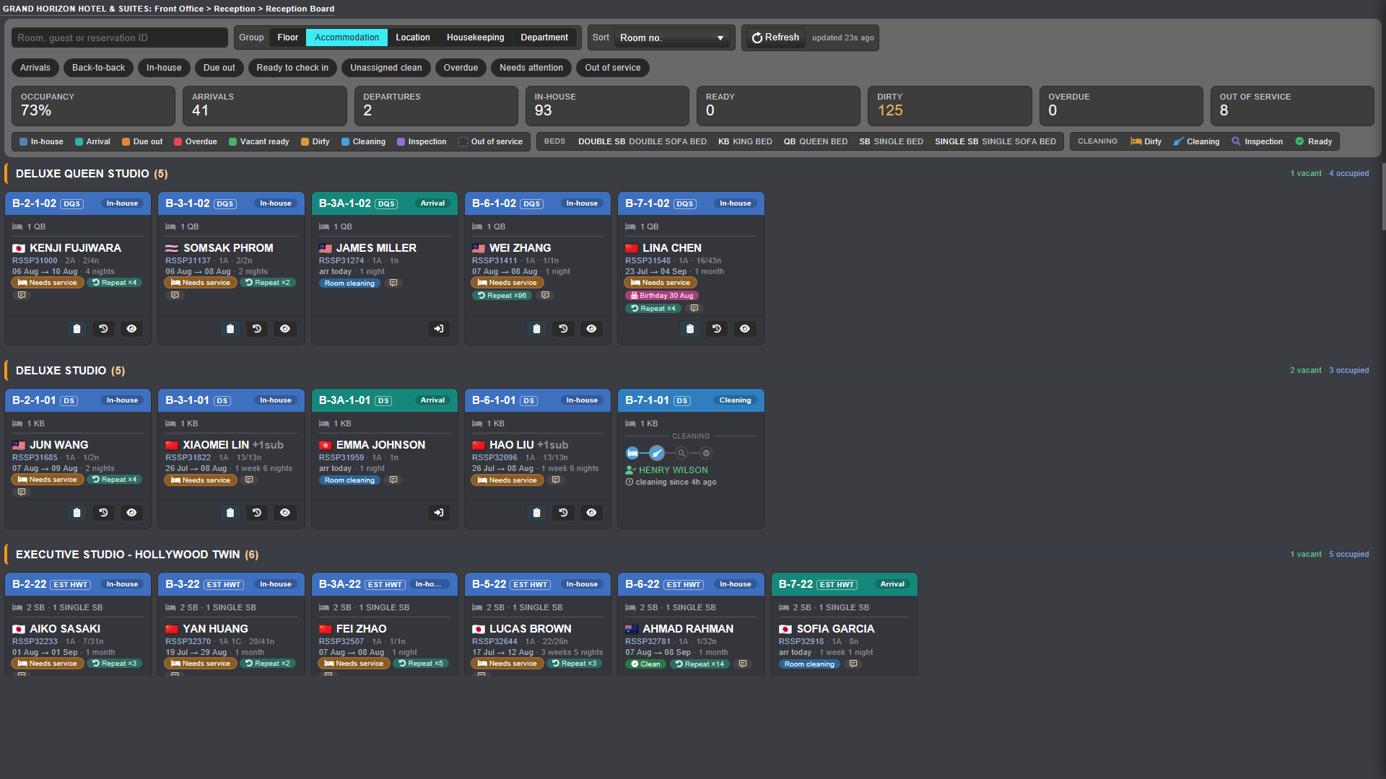
FRONT OFFICE · PMS
The whole guest journey on one live board
Individual, group, corporate and online reservations with deposit scheduling
Combined reservation sets — mixed dates, packages, venues and guest allocations in one booking
Drag-and-drop room planning with live room status from housekeeping
Folio charges, routing, split and transfer billing — all in real time
Registration cards, digital key cards, express checkout
Live Reception Board — capture from a production property (guest data anonymized)
ehors-tech.com
5
Notes:
USP: combined reservation sets and flexible live billing — most PMS platforms force one reservation pattern and fixed folio logic.

Slide 6
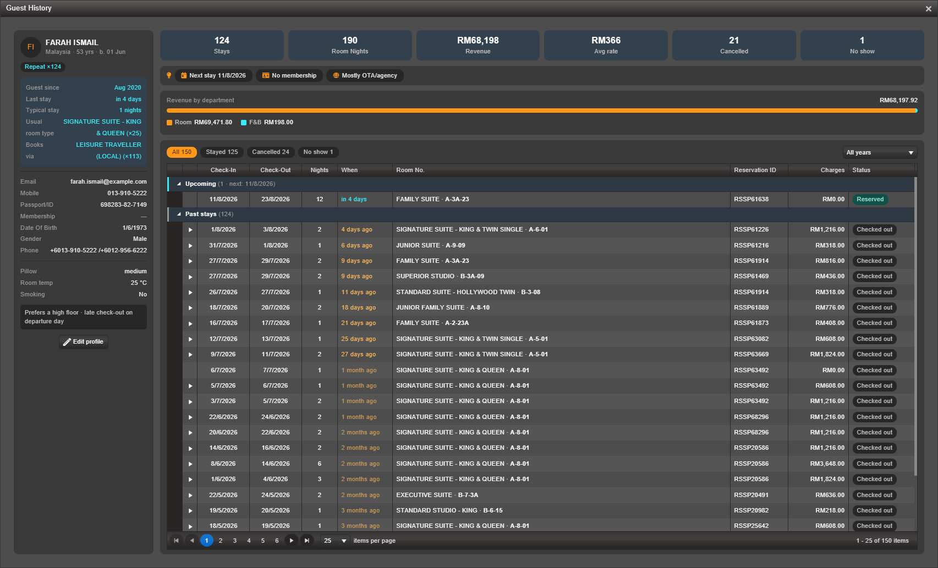
GUEST CRM
Know every guest before they reach the desk
360° profile — every stay, revenue by department, preferences, repeat count
VIP levels and repeat-guest recognition, one click from the front desk
Loyalty program with benefit tiers and eValue wallet
Questionnaires, mail-blast campaigns and communication history
A hotel CRM without buying a second system
Guest History 360° — CRM profile surfaced at check-in
ehors-tech.com
6
Notes:
Your PMS already knows your repeat guests — WinX surfaces that at check-in with no separate CRM purchase.

Slide 7
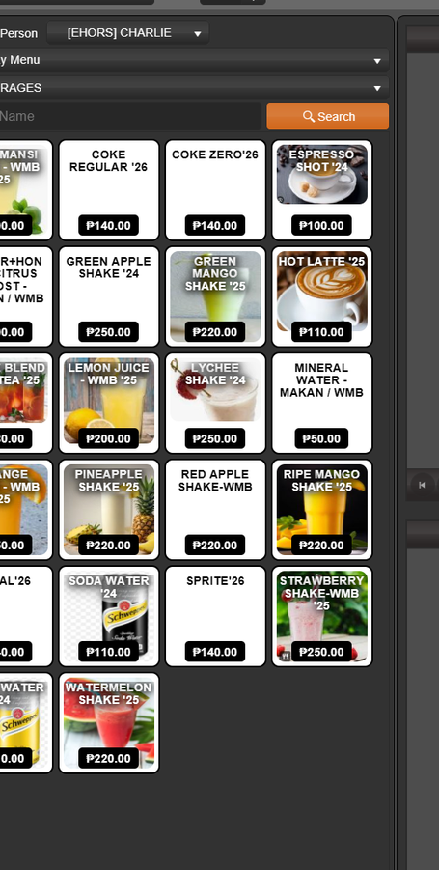
POINT OF SALES · F&B
Five outlet types, one revenue stream
Restaurant, fast food, retail, theme park and spa POS — configured from one admin panel
Table management, course ordering, bill split, void and discount control
Room charging posts straight to the guest folio
QR-code ordering for guests and a mobile app for waiters
Recipe costing deducts stock automatically at every sale
Restaurant POS — touch ordering at a live property
ehors-tech.com
7
Notes:
Multi-outlet POS is native, not an add-on. Sales post to the same folio and GL as rooms.

Slide 8
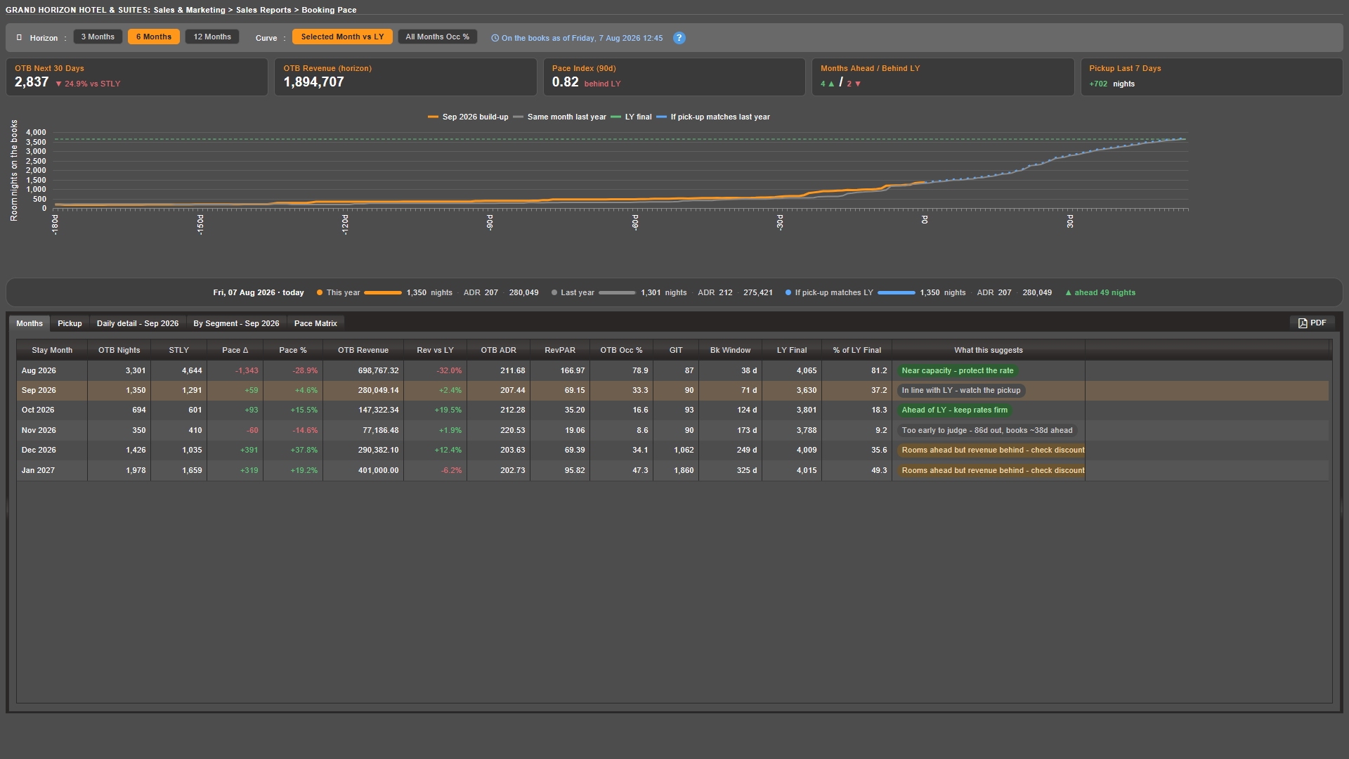
REVENUE & DISTRIBUTION
See if you’re ahead or behind — in time to act
Booking Pace — nights on the books vs the same time last year, with pick-up
7-day and 10-day occupancy forecasts and pickup reports
Rate codes, early-bird, long-stay, promo codes, surcharge calendars
Segment and channel performance reporting
Direct booking engine on live availability — cut OTA dependence
Booking Pace report — build-up curve with plain-language reading per month
ehors-tech.com
8
Notes:
A raw on-the-books number tells you nothing; compared to same-time-last-year it becomes a verdict in time to act.

Slide 9
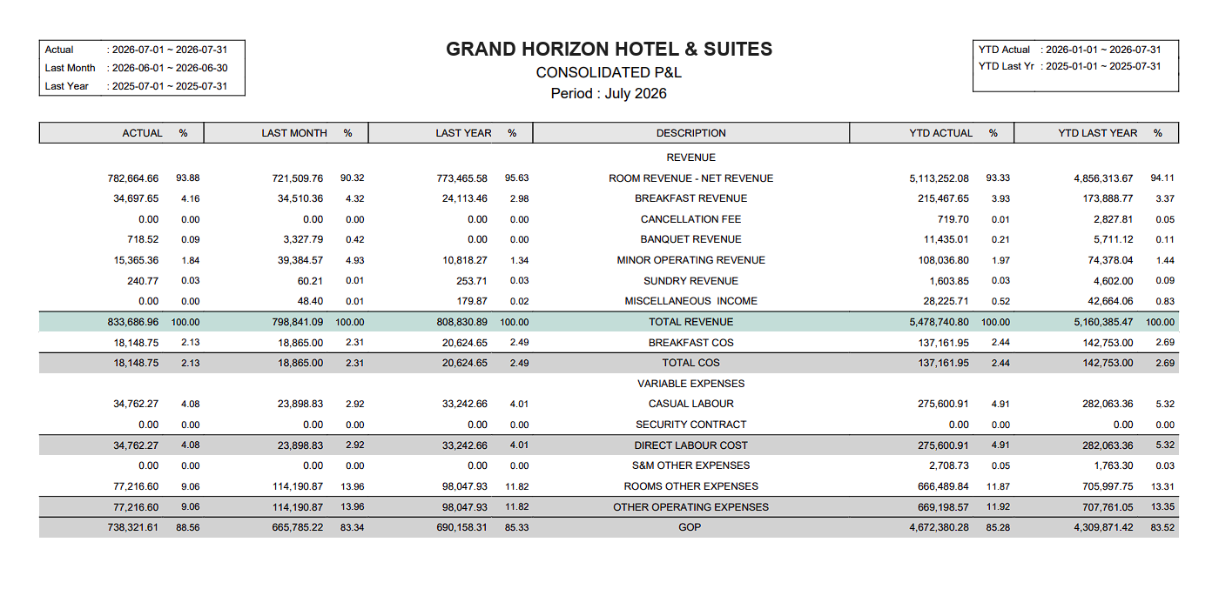
ACCOUNTING & FINANCE
P&L on the day, not at month-end
Live folio-to-GL posting with fully automated night audit
GL, AP, AR, fixed assets, budgets and multi-currency in one suite
Consolidated group reporting with cross-property GL balancer
Malaysian MyInvois (LHDN) e-Invoice compliance built in
Audit trail on every transaction — employee ID and timestamp
Consolidated P&L — generated from live GL aggregates
ehors-tech.com
9
Notes:
"Good night, night auditor" — journals post automatically; finance reads live figures while the month is still running.

Slide 10
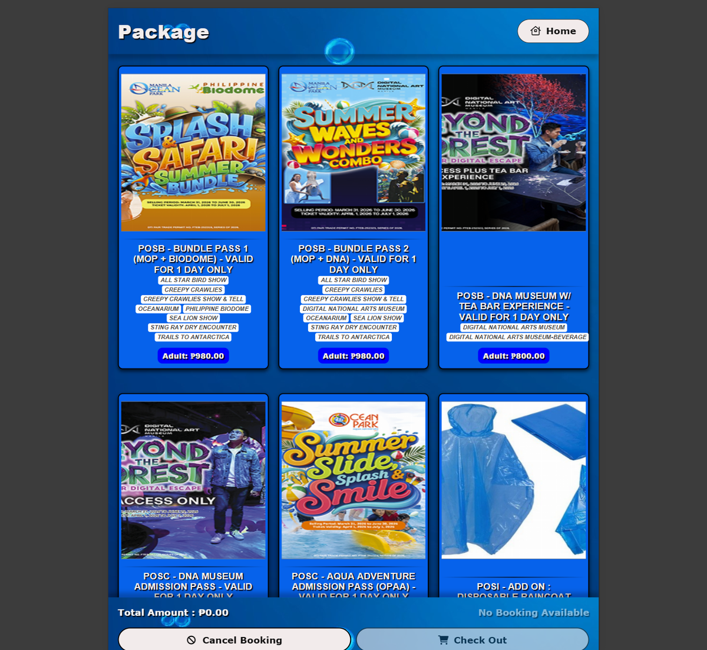
THEME PARK & ATTRACTIONS
Run the park gate like a front desk
Ticket types, passes, packages and group tickets
Kiosk self-service sales and online ticketing
Turnstile integration — access control and real-time visitor count
eValue digital wallet: top-up, redeem, cashless in-park spending
One folio bridges tickets, rooms, retail and F&B — the Manila Ocean Park model
Park ticketing & packages — kiosk and counter sales
ehors-tech.com
10
Notes:
Reference: Manila Ocean Park — oceanarium, Hotel H2O, in-park retail, spa and kiosks on one install.

Slide 11
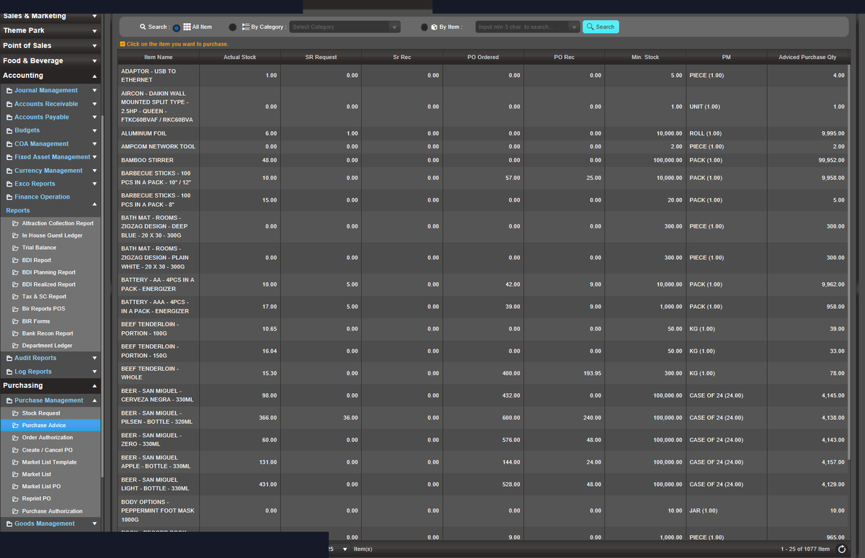
PURCHASING · INVENTORY · F&B COST
From requisition to payment, without leaks
Requisition → purchase order → goods receipt → supplier invoice → AP matching
Supplier management with pricing history and approval workflow
Multi-location stock: movements, transfers, counts and audits
Recipe and menu costing tied to POS — stock deducts at sale
Purchase advice and purchasing analytics
Purchase advice — procurement workflow at a live resort
ehors-tech.com
11
Notes:
Procurement, inventory and F&B costing close the loop with POS and AP — no rekeying between systems.

Slide 12
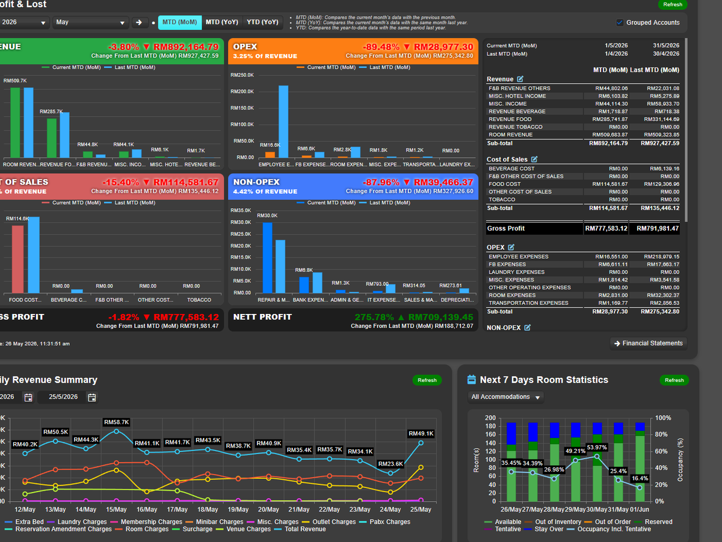
MULTI-PROPERTY
Manage a group, not just a hotel
Unlimited properties on a single installation — one codebase, per-property config
One employee, many properties — access tailored per property
Property-specific rates, settings, taxes and translations
Consolidated GL, cross-property analytics, head-office dashboards
Legal-entity switcher for groups with mixed ownership structures
Executive overview dashboard — group performance at a glance
ehors-tech.com
12
Notes:
Multi-property is day-one architecture, not an upgrade: 70+ properties run on this model today.

Slide 13




WHAT SETS WINX APART
What typical PMS platforms can’t do
Combined reservation sets
Flexible live billing
One booking holds many stays — different check-in/out dates, packages, rates, venues and guest allocations under a single reservation ID.
Master bill, routed charges, split by guest or company, transfer between folios — restructured in real time, before or after check-in.
Real-time operations
Paperless, anywhere
Figures move the moment they happen. No waiting for day-end processing — reports, folios and GL are live.
Browser-based workflows since 2002 — front desk, reservations and management work from any location with internet.
ehors-tech.com
13
Notes:
Sales line: while many PMS platforms force one reservation pattern and fixed folio logic, WinX supports mixed-date/mixed-package reservation sets and live billing controls in real time, fully paperless, from anywhere.

Slide 14
COMPARISON
WinX vs the typical stack
Capability | WinX | Typical PMS
Full PMS (reservations, front office) | Included | Included
Multi-outlet POS — all outlet types | Included | Paid add-on
Full accounting (GL / AP / AR / assets) | Included | Paid add-on
HR with biometric time & attendance | Included | Paid add-on
Theme park, kiosk & turnstile | Included | Paid add-on
Spa & wellness module | Included | Paid add-on
CRM & loyalty program | Included | Limited
Multi-property from day one | Included | Paid add-on
e-Invoice compliance (MY MyInvois) | Included | Paid add-on
Staff & guest mobile apps | Included | Limited
ehors-tech.com
14
Notes:
Everything in the left column ships inside WinX. With a typical PMS, most rows are separate purchases with separate vendors and interfaces.

Slide 15















CUSTOMERS
Trusted across APAC — city hotels to resort cities
A selection of the 70+ properties served across MY · PH · ID · TH · AU · KR. Some may have changed ownership or systems since rollout — list is illustrative.
ehors-tech.com
15
Notes:
Highlight relevant references per prospect: theme parks → Manila Ocean Park / Cebu Ocean Park; city hotels → I'M Hotel, Signature KL; resorts → Atmosphere, Taman Simalem; large-scale → Petronas Pengerang.

Slide 16



DEPLOYMENT · SECURITY · SUPPORT
Your infrastructure, your choice — secured
Security & compliance
On-premise
Role-based access — every employee sees only what they’re authorized for, per property
Full control · property-LAN speed · offline capable · your hardware
Full audit trails — every change logged with employee ID and timestamp
Encrypted, SSL-aware session management
Cloud / hosted
MyInvois e-Invoice with digital signatures (LHDN compliant)
No hardware cost · automatic backups · scale on demand · multi-region ready
DKIM-signed transactional email
Implementation & support
Both run the same WinX platform — migrate between them as you grow.
Modular onboarding — start with core modules, expand as you grow
Built-in training program, per-program reference manuals
Help desk with mobile alerts · daily server monitoring
ehors-tech.com
16
Notes:
Deployment is a choice, not a constraint. Security: RBAC per property, full audit trails, encrypted sessions, MyInvois digital signatures, DKIM email.

Slide 17


See WinX running your operation.
Request a tailored demo — your property mix, your workflows, a proposal and quote to match.
Request a demo →
ehors-tech.com
info@ehors.com
WinX by EHORS · Built for hospitality. Designed for growth.
Notes:
Close: invite them to a tailored demo at ehors-tech.com (demo request form) or info@ehors.com.

